Slide 1
Music Mixer: Phase 3
By Tyler Lennen and Prabhdeep Samra

Slide 2

Use cases of Music Mixer
Up-to-date Music Database
Users can:
Create playlists
Search songs based on keywords
Find top songs based on popularity
Editors can:
Add new songs
Update songs

Slide 3
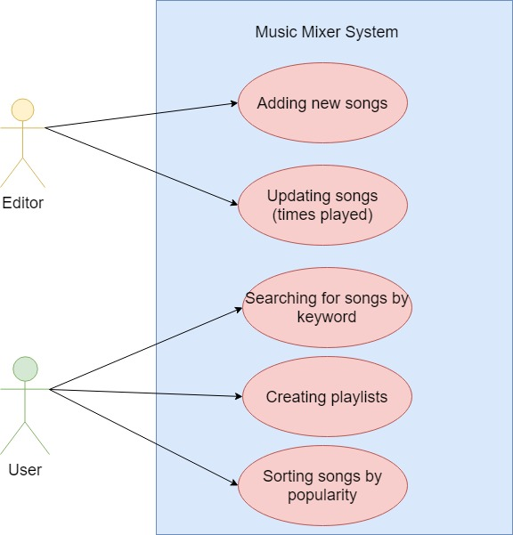
UML Diagram

Slide 4
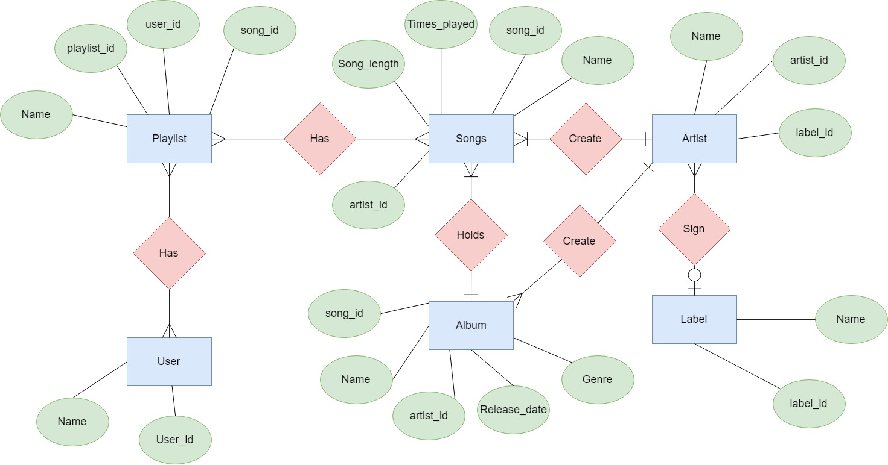
ER Diagram

Slide 5
Relation Schema
Label(name, label_id)
(0-1 -> Many) Artist
Artist(name, artist_id, label_id)
(1->Many) Songs and Album
Songs(name, song_id, artist_id, song_length, times_played)
(Many->1)Album/Artist
(Many->Many)Playlist)
Album(name, song_id, artist_id, release_date, genre)
(1->Many)Songs
(Many->1)Artist
Playlist(name, playlist_id, song_id, user_id)
(Many->Many)User
(Many->Many)Songs
User(name,user_id)
(Many->Many)Playlist

Slide 6


Implementation
SQLite
Native Python Application using tkinter

